Slide 1
Content
1.1 | Difference between Data analysis and analytics
1.2 | Data Science Lifecycle
1.3 | Roles and Challenges in Data Science
1.4 | Types of data attributes
1.5 | Major tasks in Data Pre-processing
1.6 | Data Integration - Entity Identification Problem, Tuple Duplication
1.7 | Data Transformation – Min-max normalization, z-score normalization, and Decimal scaling; Binning
1.8 | Data encoding – Label encoding and one-hot encoding
1.9 | Pre-processing

Slide 2
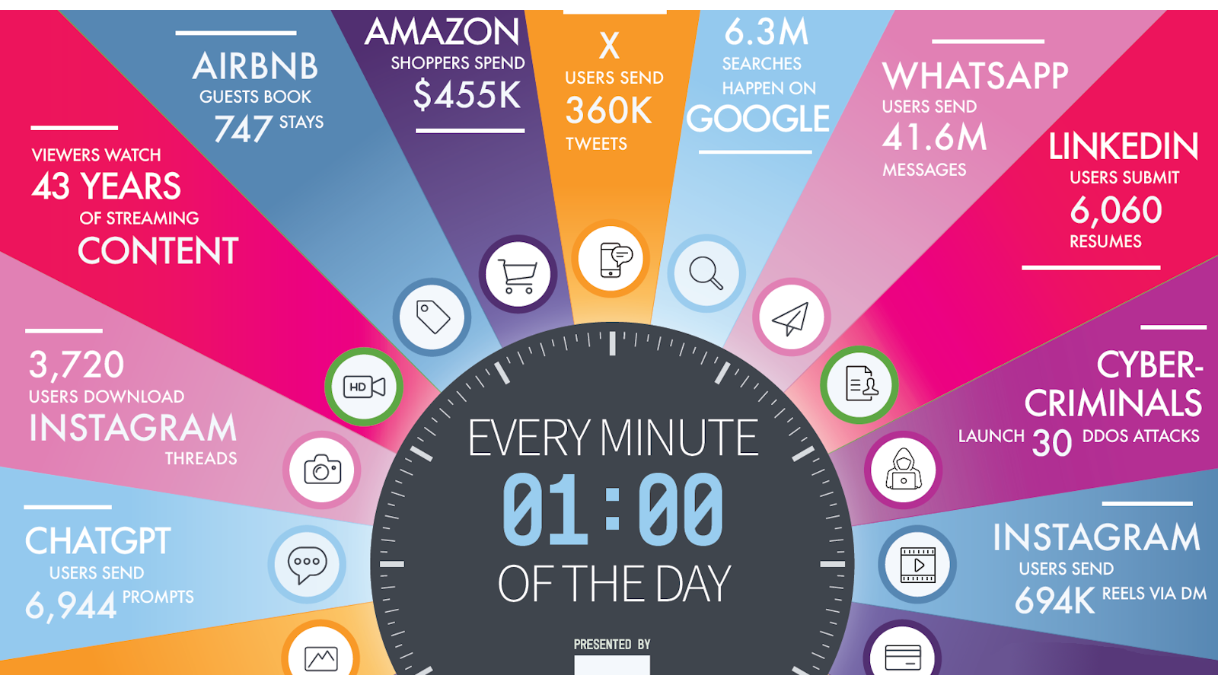
An Internet One Minute : 2025

Slide 3
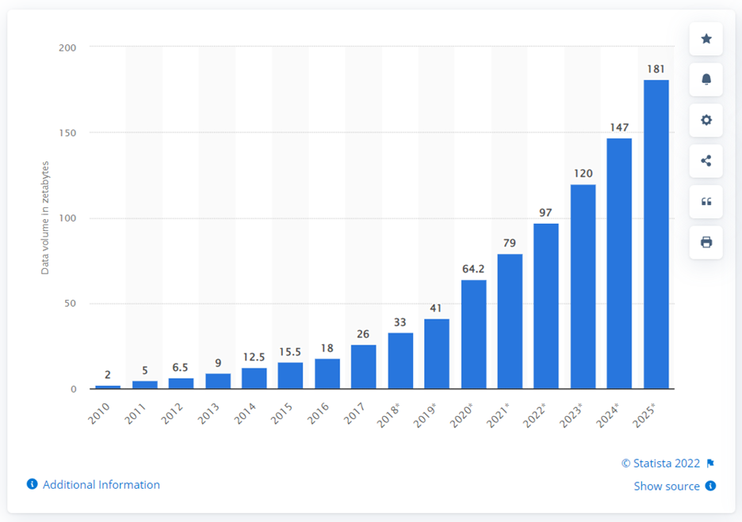
Annual Growth Rate

Slide 4
The Information Age is Here!
"Data doubles about every year, but useful information seems to be decreasing."
Margaret Dunham, "Data Mining Techniques & Algorithms",
"There is a growing gap between the generation of data and our understanding of it."
Witten & Frank, "Data Mining: Practical Machine Learning Tools",

Slide 5
Evolution of Sciences
Before 1600, empirical science
1600-1950s, theoretical science
Each discipline has grown a theoretical component. Theoretical models often motivate experiments and generalize our understanding.
1950s-1990s, computational science
Computational Science traditionally meant simulation. It grew out of our inability to find closed-form solutions for complex mathematical models.
1990-now, data science
The flood of data from new scientific instruments and simulations
The ability to economically store and manage petabytes of data online
The Internet and computing Grid that makes all these archives universally accessible
Scientific info. management, acquisition, organization, query, and visualization tasks scale almost linearly with data volumes.
Data science is a major new challenge!

Slide 6
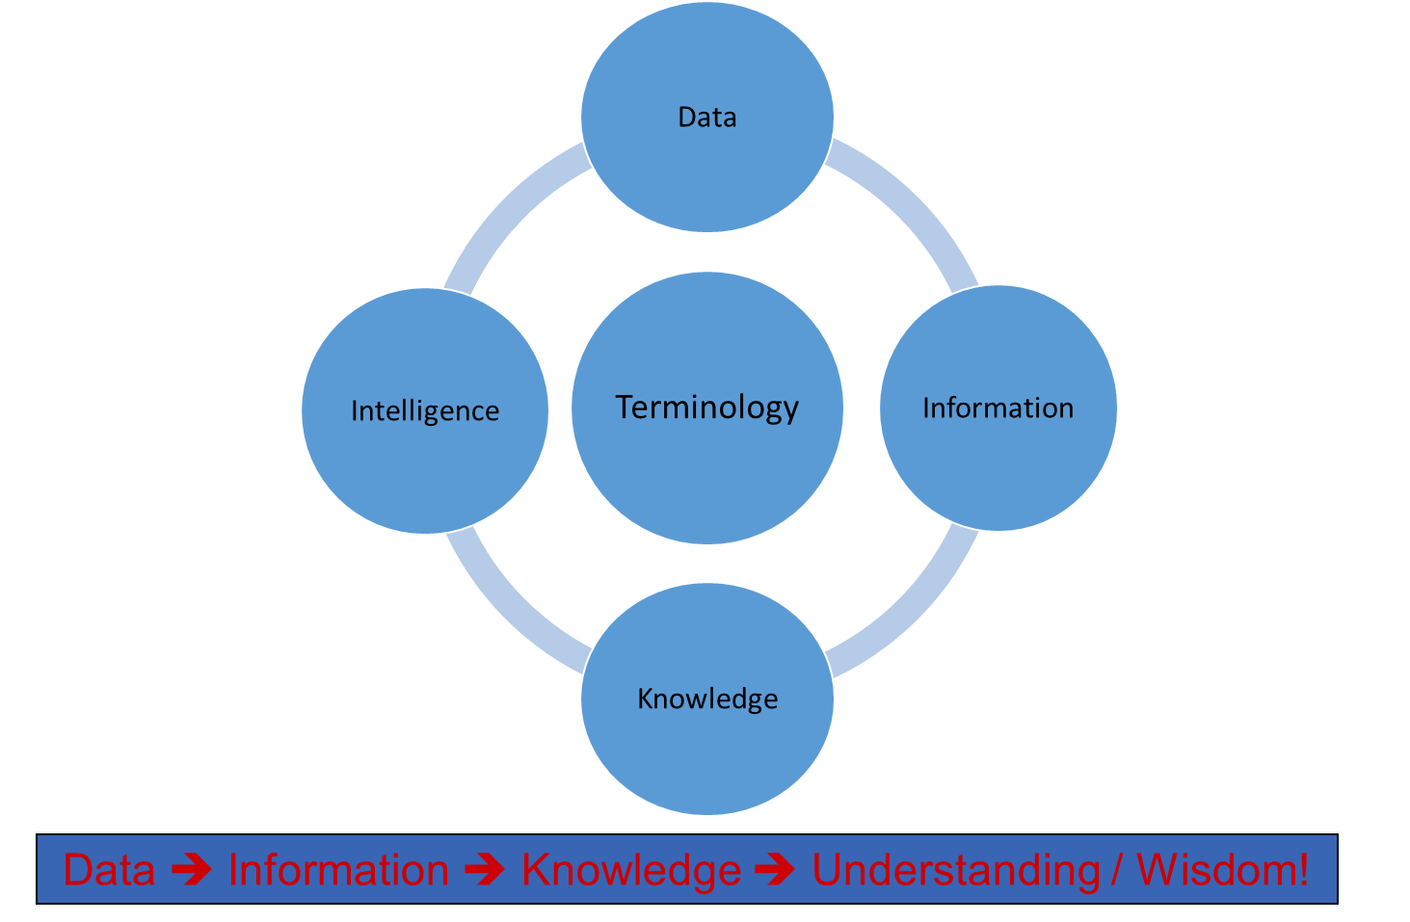
Basic Terminology

Slide 7
Data leads to Knowledge leads to Understanding
EXAMPLE
Data = ages and heights of children (stored in database)
Information = sorting as per age
Knowledge = the older children tend to be taller
Understanding = children’s bones grow as they get older
Data ➔ Information ➔ Knowledge ➔ Understanding / Wisdom!

Slide 8
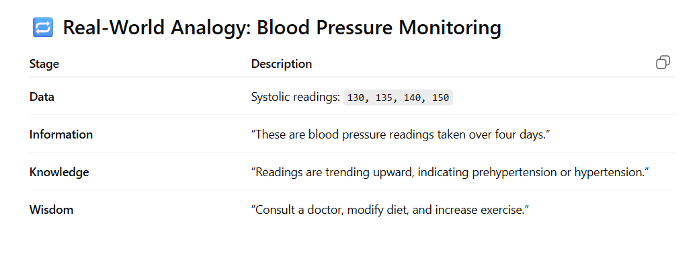
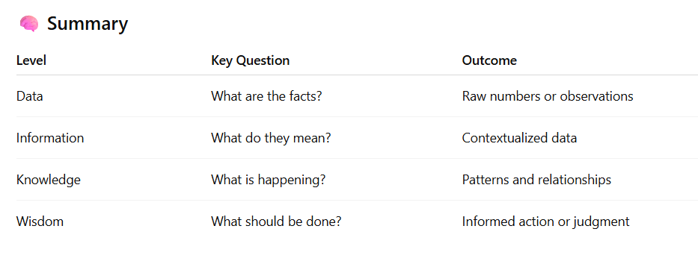
Example

Slide 9
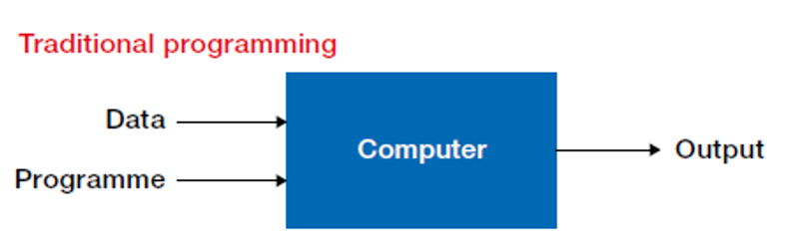
Traditional Programming Vs Machine Learning

Slide 10
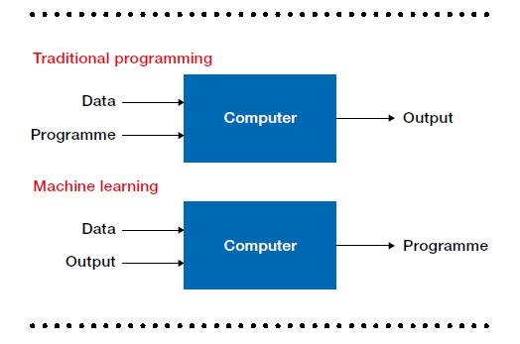
Traditional Programming Vs Machine Learning

Slide 11
Types of Data
Relational Data (Tables/Transaction/Legacy Data)
Text Data (Web)
Semi-structured Data (XML)
Graph Data
Social Network, Semantic Web (RDF), …
Streaming Data
You can afford to scan the data once

Slide 12
Big Data is any data that is expensive to manage and hard to extract value from
Volume
The size of the data
Velocity
The latency of data processing relative to the growing demand for interactivity
Variety and Complexity
the diversity of sources, formats, quality, structures.

Slide 13
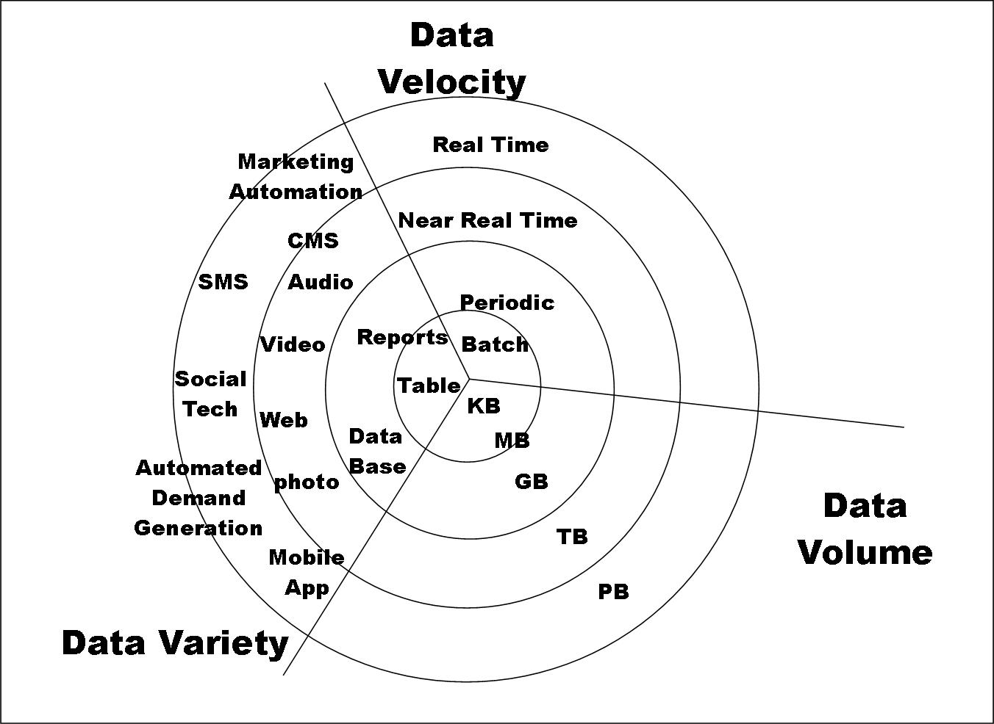

Slide 14
“… the job in the next 10 years will be statisticians,” Hal Varian, Google Chief Economist
The U.S. will need 140,000-190,000 predictive analysts and 1.5 million managers/analysts by 2018. McKinsey Global Institute’s June 2011
New Data Science institutes being created or repurposed – NYU, Columbia, Washington, UCB,...
New degree programs, courses, boot-camps:
e.g., at Berkeley: Stats, I-School, CS, Astronomy…
One proposal (elsewhere) for an MS in “Big Data Science”

Slide 15
Data Analysis

Slide 16
Data Analytics
Analytics – Analytics is the discovery, interpretation, and communication of meaningful patterns or summery in data.
Data Analytics (DA) is the process of examining data sets in order to draw conclusion about the information it contains.
Analytics is not a tool or technology, rather it is the way of thinking and acting on data.

Slide 17
Application of Data Analytics
Healthcare
Travel
Gaming
Energy Management

Slide 18
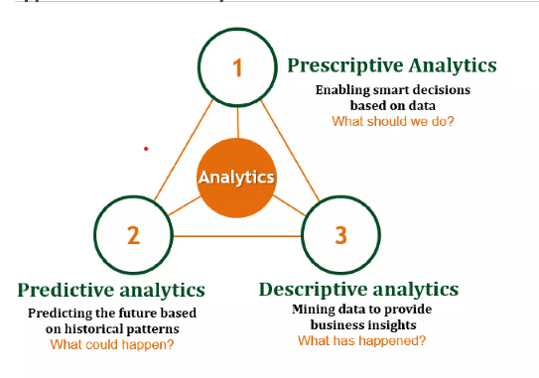
Types of Data Analytics
Descriptive Analytics
Predictive Analytics
Prescriptive Analytics

Slide 19
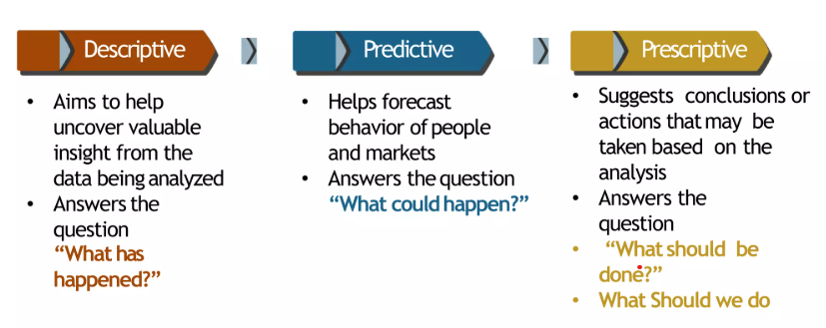
Types of Data Analytics

Slide 20
What is Data Science?
Data Science is a combination of multiple disciplines that uses statistics, data analysis, and machine learning to analyze data and to extract knowledge and insights from it.
Data Science is about data gathering, analysis and decision-making.
Data Science is about finding patterns in data, through analysis, and make future predictions.
By using Data Science, companies are able to make:
Better decisions (should we choose A or B)
Predictive analysis (what will happen next?)
Pattern discoveries (find pattern, or maybe hidden information in the data)

Slide 21
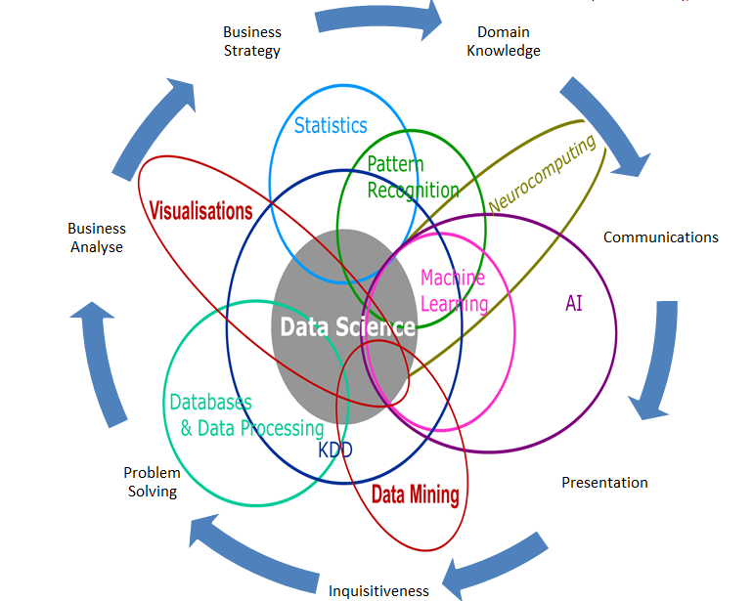
Data Science is Multidisciplinary

Slide 22
Where is Data Science Needed?
Data Science is used in many industries in the world today, e.g. banking, consultancy, healthcare, and manufacturing.
Examples
For route planning: To discover the best routes to ship
To foresee delays for flight/ship/train etc. (through predictive analysis)
To create promotional offers
To find the best suited time to deliver goods
To forecast the next years revenue for a company
To analyze health benefit of training
To predict who will win elections

Slide 23
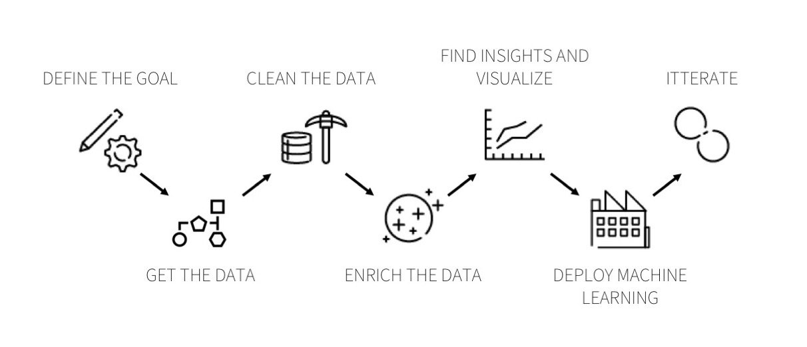
Data Science Lifecycle

Slide 24
Step 1: Understand the Business
Understanding the business or activity that your data project is part of is key to ensuring its success and the first phase of any sound data analytics project. To motivate the different actors necessary to getting your project from design to production, your project must be the answer to a clear organizational need. Before you even think about the data, go out and talk to the people in your organization whose processes or whose business you aim to improve with data. Then, sit down to define a timeline and concrete key performance indicators. I know, planning and processes seem boring, but, in the end, they are an essential first step to kickstart your data initiative!

Slide 25
Step 2: Get Your Data
Once you’ve gotten your goal figured out, it’s time to start looking for your data, the second phase of a data analytics project. Mixing and merging data from as many data sources as possible is what makes a data project great, so look as far as possible.

Slide 26
Step 3: Explore and Clean Your Data
Once you’ve gotten your data, it’s time to get to work on it in the third data analytics project phase. Start digging to see what you’ve got and how you can link everything together to achieve your original goal. Start taking notes on your first analyses and ask questions to business people, the IT team, or other groups to understand what all your variables mean.

Slide 27
Step 4: Enrich Your Dataset
Now that you have clean data, it’s time to manipulate it in order to get the most value out of it. You should start the data enrichment phase of the project by joining all your different sources and group logs to narrow your data down to the essential features. One example of that is to enrich your data by creating time-based features, such as:
Extracting date components (month, hour, day of the week, week of the year, etc.)
Calculating differences between date columns
Flagging national holidays

Slide 28
Step 5: Build Helpful Visualizations
You now have a nice dataset (or maybe several), so this is a good time to start exploring it by building graphs. When you’re dealing with large volumes of data, visualization is the best way to explore and communicate your findings and is the next phase of your data analytics project.

Slide 29
Step 6: Get Predictive
The next data science step, phase six of the data project, is when the real fun starts. Machine learning algorithms can help you go a step further into getting insights and predicting future trends.
By working with clustering algorithms (aka unsupervised), you can build models to uncover trends in the data that were not distinguishable in graphs and stats. These create groups of similar events (or clusters) and more or less explicitly express what feature is decisive in these results.

Slide 30
Step 7: Iterate, Iterate, Iterate
The main goal in any business project is to prove its effectiveness as fast as possible to justify, well, your job. The same goes for data projects. By gaining time on data cleaning and enriching, you can go to the end of the project fast and get your initial results. This is the final phase of completing your data analytics project and one that is critical to the entire data life cycle.

Slide 31
Roles in Data Science
Data Scientist
Primary responsibilities:
Build predictive models and run experiments
Perform exploratory data analysis (EDA)
Interpret results and communicate insights
Develop machine-learning pipelines
Skills: Statistics, Python/R, ML algorithms, Visualization, Communication.

Slide 32
Roles in Data Science
2. Data Analyst
Primary responsibilities:
Analyze historical data
Create dashboards and reports
Identify trends and insights
Support business decision-making
Skills: SQL, Excel, BI tools (Tableau/Power BI), Data Visualization, Basic Statistics.

Slide 33
Roles in Data Science
3. Data Engineer
Primary responsibilities:
Build and maintain data pipelines
Ensure data quality, availability, and scalability
Work with databases, streaming systems, and cloud platforms
Skills: ETL, SQL/NoSQL, Spark, Hadoop, Cloud (AWS/Azure/GCP), Python/Scala.

Slide 34
Roles in Data Science
4. Machine Learning Engineer
Primary responsibilities:
Productionize and deploy ML models
Optimize performance and scalability
Build MLOps workflows
Monitor and maintain models in production
Skills: ML algorithms, Cloud deployment, APIs, Docker/Kubernetes, CI/CD.

Slide 35
Roles in Data Science
5. Business Analyst / Product Owner (Data)
Primary responsibilities:
Translate business goals into data requirements
Define KPIs and evaluate impact
Coordinate between data teams and stakeholders
Skills: Business Understanding, Communication, Documentation, Prioritization.

Slide 36
Challenges in Data Science
Data Availability and Quality
Integration of Data
The ability to scale
Data Security and Privacy
Model Interpretability
Adapting to the Quick Advancements in Technology
Lack of Talent

Slide 37
Types of Data Sets
Structured Datasets: Highly organized data with a well-defined schema, typically in tabular form (rows and columns) like CSV or SQL files.
Semi-Structured Datasets: Data that does not fit into rigid tables but contains tags or markers to separate elements, such as JSON, XML, or YAML.
Unstructured Datasets: Data with no predefined format, often making up the bulk of "Big Data." Examples include emails, PDFs, videos, and social media posts.
Numerical (Quantitative): Consists of numbers used for mathematical operations. This includes Discrete data (countable whole numbers) and Continuous data (measurable values like height or temperature).
Categorical (Qualitative): Represents characteristics or groups. This includes Nominal data (labels without order, e.g., hair color) and Ordinal data (ranked categories, e.g., survey ratings).
Time-Series: Data points recorded in chronological order to track trends over time, such as daily stock prices or weather records.
Multimedia: Collections of non-textual data like images, audio recordings, and video files.
Spatial: Geographically referenced information such as GPS coordinates or satellite imagery

Slide 38
Data Objects
Data sets are made up of data objects.
A data object represents an entity.
Examples:
Sales database: customers, store items, sales
Medical database: patients, treatments
University database: students, professors, courses
Also called samples, examples, instances, data points, objects, tuples.
Data objects are described by attributes.
Database rows -> data objects; columns ->attributes.

Slide 39
Attributes
Attribute (or Dimensions, Features, Variables): A data field, representing a characteristic or feature of a data object.
E.g., customer _ID, name, address
Types:
Nominal
Binary
Numeric: Quantitative
Interval-scaled
Ratio-scaled

Slide 40
Attribute Types
Nominal: Categories, States, or “Names of things”
Hair_color = {auburn, black, blond, brown, grey, red, white}
Marital status, occupation, ID numbers, zip codes
Binary
Nominal attribute with only 2 states (0 and 1)
Symmetric binary: both outcomes equally important
e.g., gender
Asymmetric binary: Outcomes not equally important.
e.g., medical test (positive vs. negative)
Convention: assign 1 to most important outcome (e.g., HIV positive)
Ordinal
Values have a meaningful order (ranking) but magnitude between successive values is not known.
Size = {small, medium, large}, grades, army rankings

Slide 41
Numeric Attribute Types
Quantity (integer or real-valued)
Interval
Measured on a scale of equal-sized units
Values have order
E.g., temperature in C˚or F˚, calendar dates
No true zero-point
Ratio
Inherent zero-point
We can speak of values as being an order of magnitude larger than the unit of measurement (10 K˚ is twice as high as 5 K˚).
e.g., temperature in Kelvin, length, counts, monetary quantities

Slide 42
Discrete vs. Continuous Attributes
Discrete Attribute
Has only a finite or countably infinite set of values
E.g., zip codes, profession, or the set of words in a collection of documents
Sometimes, represented as integer variables
Note: Binary attributes are a special case of discrete attributes
Continuous Attribute
Has real numbers as attribute values
E.g., temperature, height, or weight
Practically, real values can only be measured and represented using a finite number of digits
Continuous attributes are typically represented as floating-point variables

Slide 43
Dimensionality
Definition: Refers to the number of attributes, features, or variables that the data objects in a dataset possess.
Context: A dataset with many columns (features) is considered high-dimensional.
Impact: High dimensionality can lead to the "Curse of Dimensionality," where data analysis becomes difficult, models are prone to overfitting, and data points become very sparse in the available space.

Slide 44
Sparsity
Definition: Describes a dataset condition where a large percentage of entries have zero, null, or missing values.
Context: This is common in areas like text analysis (where only a few words from a large vocabulary are used in a single document) or recommendation systems (where users only interact with a tiny fraction of available items).
Impact: Specialized data structures and algorithms are needed to efficiently store and process sparse data to save memory and improve computational speed.

Slide 45
Resolution
Definition: Refers to the granularity or scale at which the data is collected or analyzed.
Context: The patterns you can identify depend heavily on the resolution. For example, daily temperature readings show different patterns (short-term weather systems) than monthly averages (long-term climate trends).
Impact: If the resolution is too fine, patterns can be obscured by noise; if it is too coarse, important patterns might disappear altogether.

Slide 46
Distribution
Definition: Refers to how the data points are spread out or clustered across various values or ranges.
Context: Understanding the distribution (e.g., normal, skewed, uniform) helps determine appropriate statistical methods and machine learning algorithms for analysis.
Impact: The distribution of data influences measures of centrality (mean, median, mode) and dispersion (variance), which are crucial for interpreting insights.

Slide 47
Data Quality: Why Preprocess the Data?
Measures for data quality: A multidimensional view
Accuracy: correct or wrong, accurate or not
Completeness: not recorded, unavailable, …
Consistency: some modified but some not, dangling, …
Timeliness: timely update?
Believability: how trustable the data are correct?
Interpretability: how easily the data can be understood?

Slide 48
Major Tasks in Data Preprocessing
Data cleaning
Fill in missing values, smooth noisy data, identify or remove outliers, and resolve inconsistencies
Data integration
Integration of multiple databases, data cubes, or files
Data reduction
Dimensionality reduction
Numerosity reduction
Data compression
Data transformation and data discretization
Normalization
Concept hierarchy generation

